Slide 1
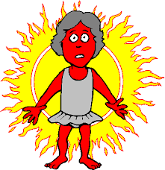
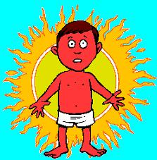

Slide 2
Benefits of the Sun
It gives us light
It gives us warmth
Helps plants to grow – fruit & vegetables
We feel happier
Sleep better
Vitamin D production which help our bones and teeth

Slide 3
Harmful effects from the sun
Dehydration
Ageing skin
Sensitive eyes
SUNBURN

Slide 4
What is Sunburn?

Slide 5
tiredness
pain
Fever above 38c
dehydration

Slide 6
blistered Skin
sensitive Skin

Slide 9
What skin type are you?
High Risk
Medium Risk
Low Risk
Freckles, fair skin,light coloured hair, blue/green eyes.

Slide 11
How do we protect ourselves from Sunburn?

