Slide 1
Special Olympics
Regional / MENA Games 2018
World Games 2019

Slide 2
What is Intellectual Disability?
IQ is below 70-75
There are significant limitations in two or more adaptive areas (skills that are needed to live, work, and play in the community, such as communication or self-care)
The condition manifests itself before the age of 18
According to the American Association of Intellectual and Developmental Disabilities

Slide 3
Special Olympics Abu Dhabi
https://www.youtube.com/watch?v=FJTPMt3CsMI

Slide 4
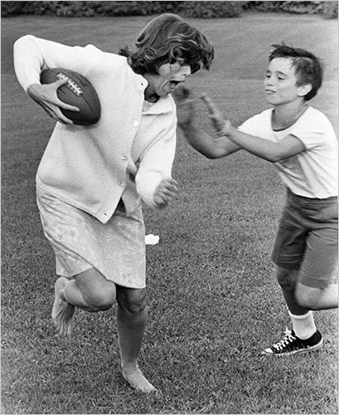
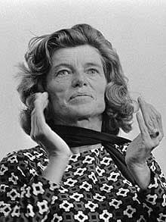
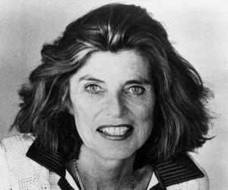
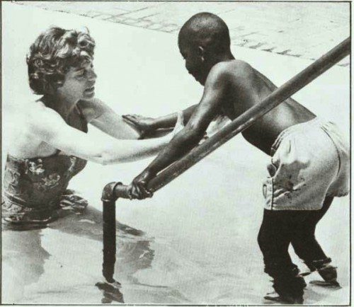
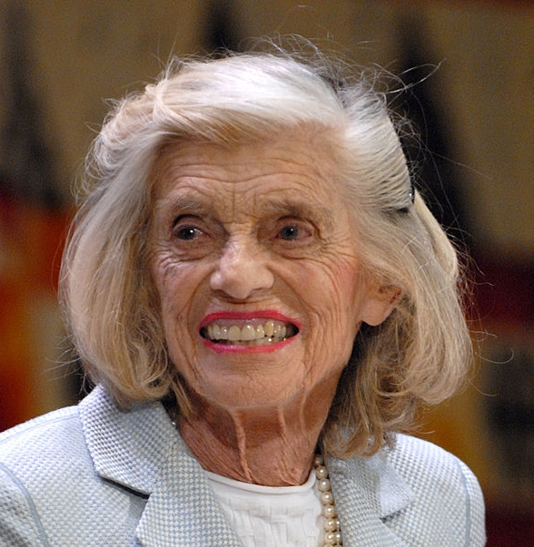
Eunice Kennedy Shriver 1921-2009

Slide 5
Special Olympic sports
Athletics, Badminton, Basketball, Equestrian Beach Volleyball, Bocce, Bowling, Cycling, Football (11-a-side, 7-a-side, 5-a-side), Golf, Gymnastics Artistic, Gymnastics Rhythmic, Handball, Judo, Kayaking, Marathon, Powerlifting, Roller Skating, Sailing,
Swimming and Open Water Swim, Table Tennis, Tennis, Triathlon, Volleyball

Slide 6
Venues: Zayed Sports City, Hazza Bin Zayed Stadium, Abu Dhabi Yacht and Sailing Club, New York University, Abu Dhabi Equestrian Club

Slide 7
Movement:
Special Olympics transforms lives through the joy of sport, every day, everywhere. We are the world’s largest sports organization for people with intellectual disabilities: with more than 4.9 million athletes in 172 countries and over a million volunteers.
The World Games is an opportunity to create a lasting impact for people with intellectual disabilities in the UAE and the MENA region.

Slide 8
BSAK involvement:
Regional Games Adopt-a-Nation: Cote d’Ivoire (Ivory Coast)
Volunteering at Regional and World Games
Sports Events – Mr Coombs
Legacy projects

Slide 9
Special Olympics 2019 facts:
7000 athletes
3000 coaches
20,000 volunteers
24 sports
170 countries
500,000 spectators

Slide 10
Avril Lavigne video In celebration of the Special Olympics 2015 in LA
https://www.specialolympics.org/fly.aspx
https://youtu.be/Vc17w3WVWPA
Changing the World through Sport video

Slide 11
https://www.volunteers.ae/specialolympics.aspx
Volunteer using the link above

