Slide 1
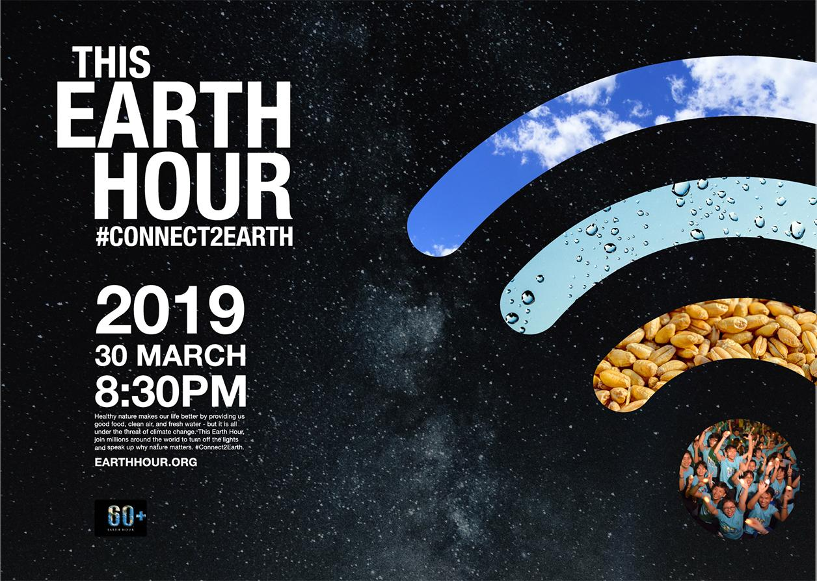
UN Global Social Leaders: Advay, Areen, Alex, Aamina & Jood.
BSAK WILL BE TAKING PART ON THURSDAY 28TH MARCH.
Notes:
JOOD:
Good morning primary school. We are the United Nation’s Global Social Leaders and are here to talk to you about Earth hour this year, and why we should all participate. Here is a short video.

Slide 3
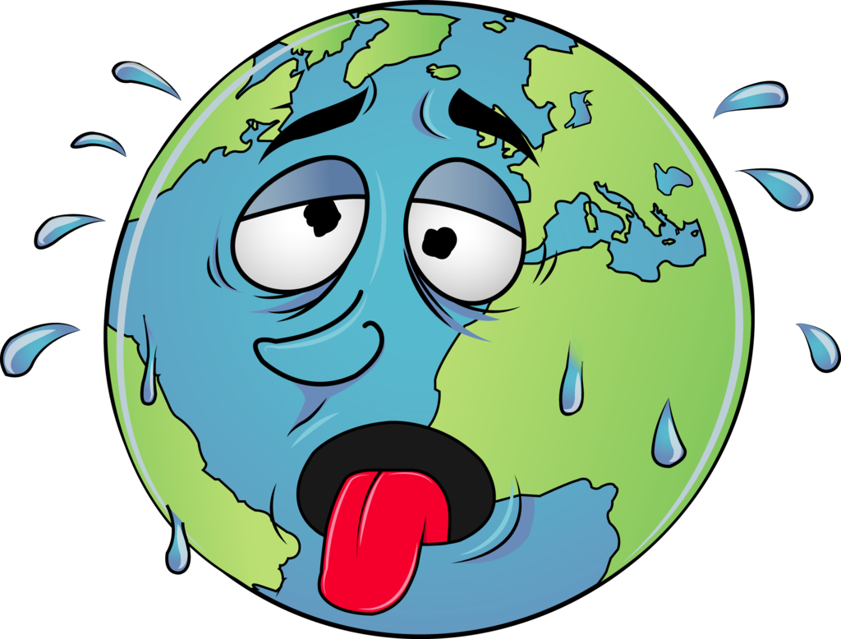
Why is BSAK taking part in Earth Hour?
It is not just about switching off for one hour a year, it’s about changing your habits which damage the environment.
It’s about knowing our actions have a negative impact our planet.
Notes:
JOOD: So why is BSAK taking part in Earth Hour? It is not just about switching off for one hour a year, it’s about changing your habits which damage the environment. It’s about making an informative decision concerning our daily actions - this includes turning off lights when leaving the room and resisting buying unnecessary clothes. An hour is not going to save the world - the key message is that every action counts and that passionate individuals can make genuine change to the way we think about our impact on the planet.
It’s about knowing our actions have a negative impact on our planet.

Slide 4
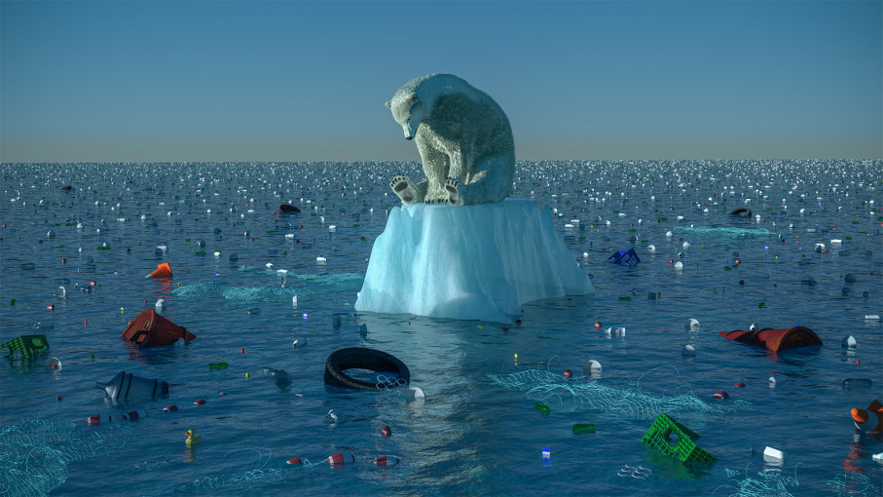
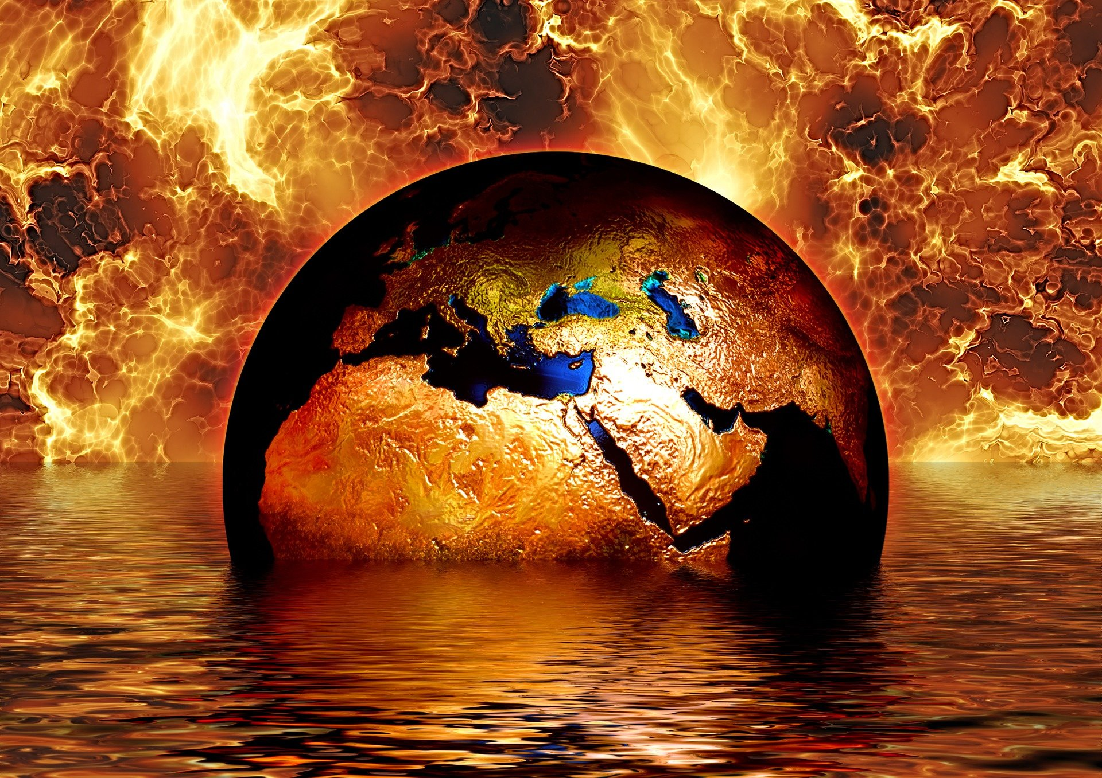
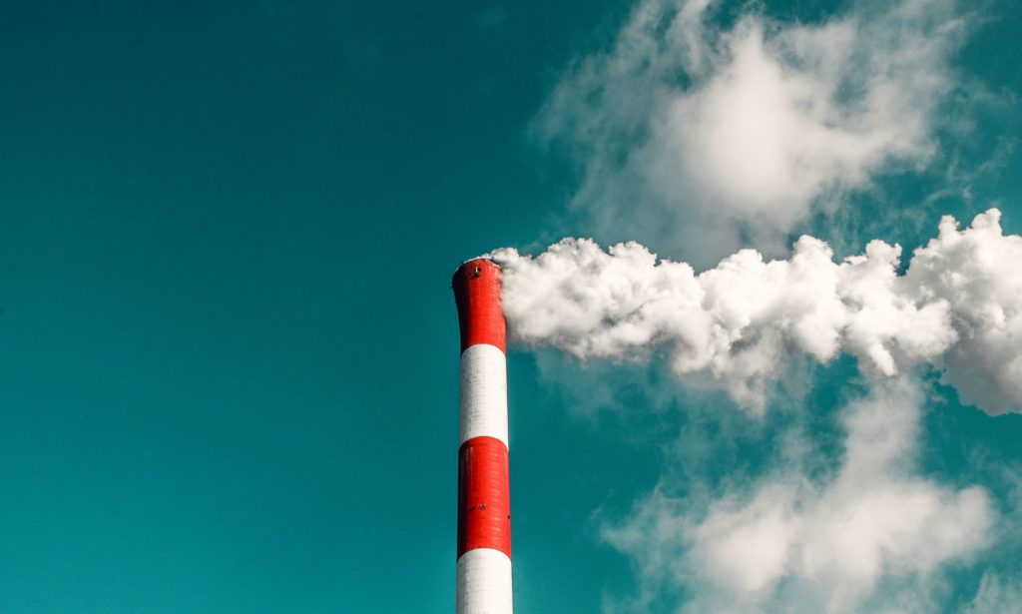
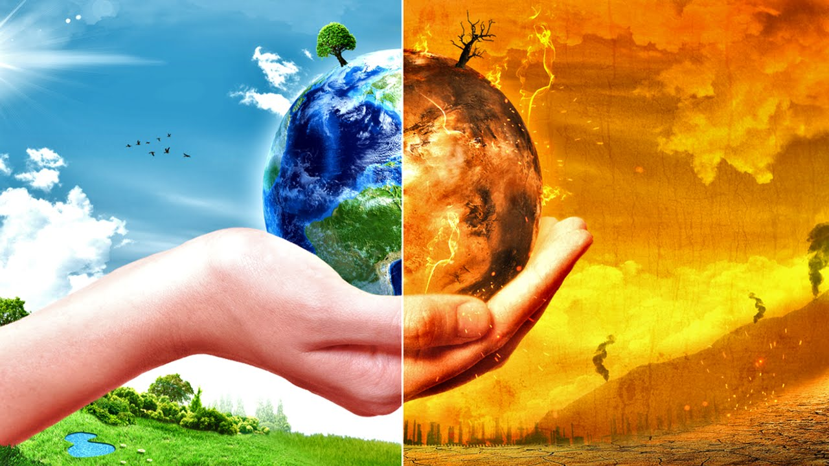
Climate Change
Notes:
AAMINA: One of the biggest problems of our life times is climate change. This is when the temperature of the Earth changes - in some places, this would mean increasing temperatures which could lead to plants, animals and people not having enough water to survive; decreasing temperatures could lead to climates that we we would not be able to survive in.
This is caused by....
Humans are producing these harmful gases because we burn coal and oil in factories to make electricity - everything you use in your home; your phone, computer, dishwasher, kettle - and to run our cars. These gases then get trapped in our atmosphere and make the world hotter. The Earth’s temperature will be so high that ice caps will melt threatening the existence of animals such as polar bears.

Slide 5
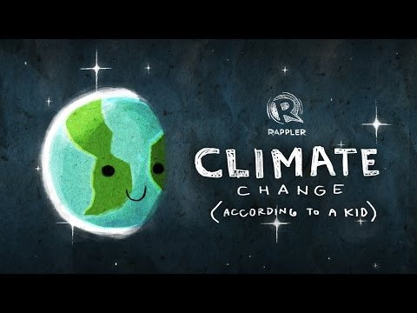
Notes:
This is a short video more about what climate change actually is.

Slide 6
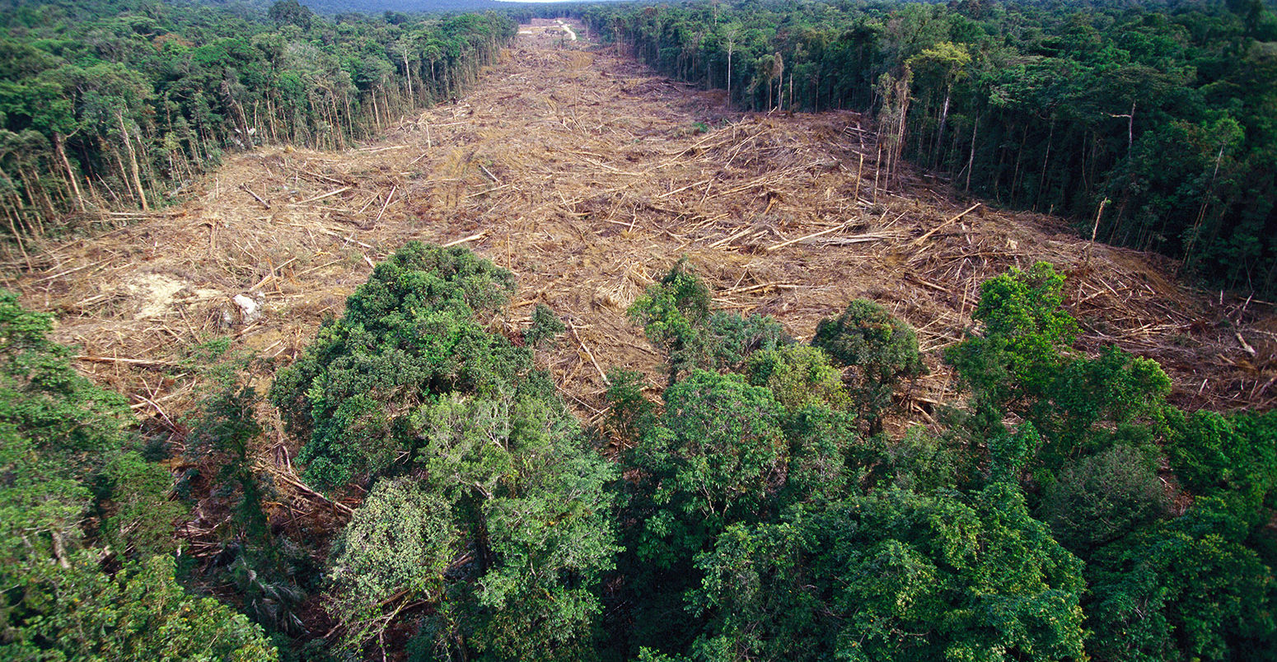
Deforestation
Deforestation destroys the size of a FOOTBALL PITCH EVERY 25 SECONDS.
Notes:
AREEN::Deforestation. This is when immense amounts of forests are cut down. The wood from these trees are then used to make things like paper and the tables and chairs you sit on. The reason why rainforests are so important is because they provide us with fresh air, they’re homes to some amazing animals and also, some plants can be used as medicine to treat severe diseases. They take away the bad gases from the atmosphere. Deforestation is also contributing to climate change because trees play a very important role in protecting the planet.

Slide 7
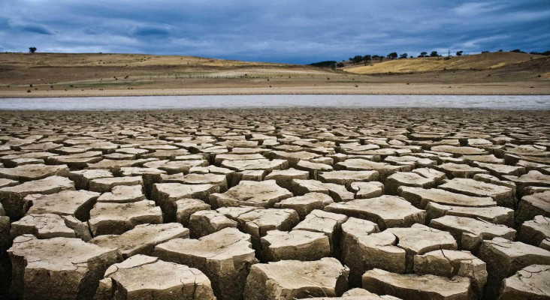
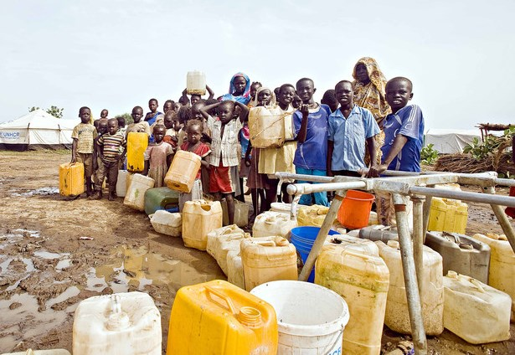
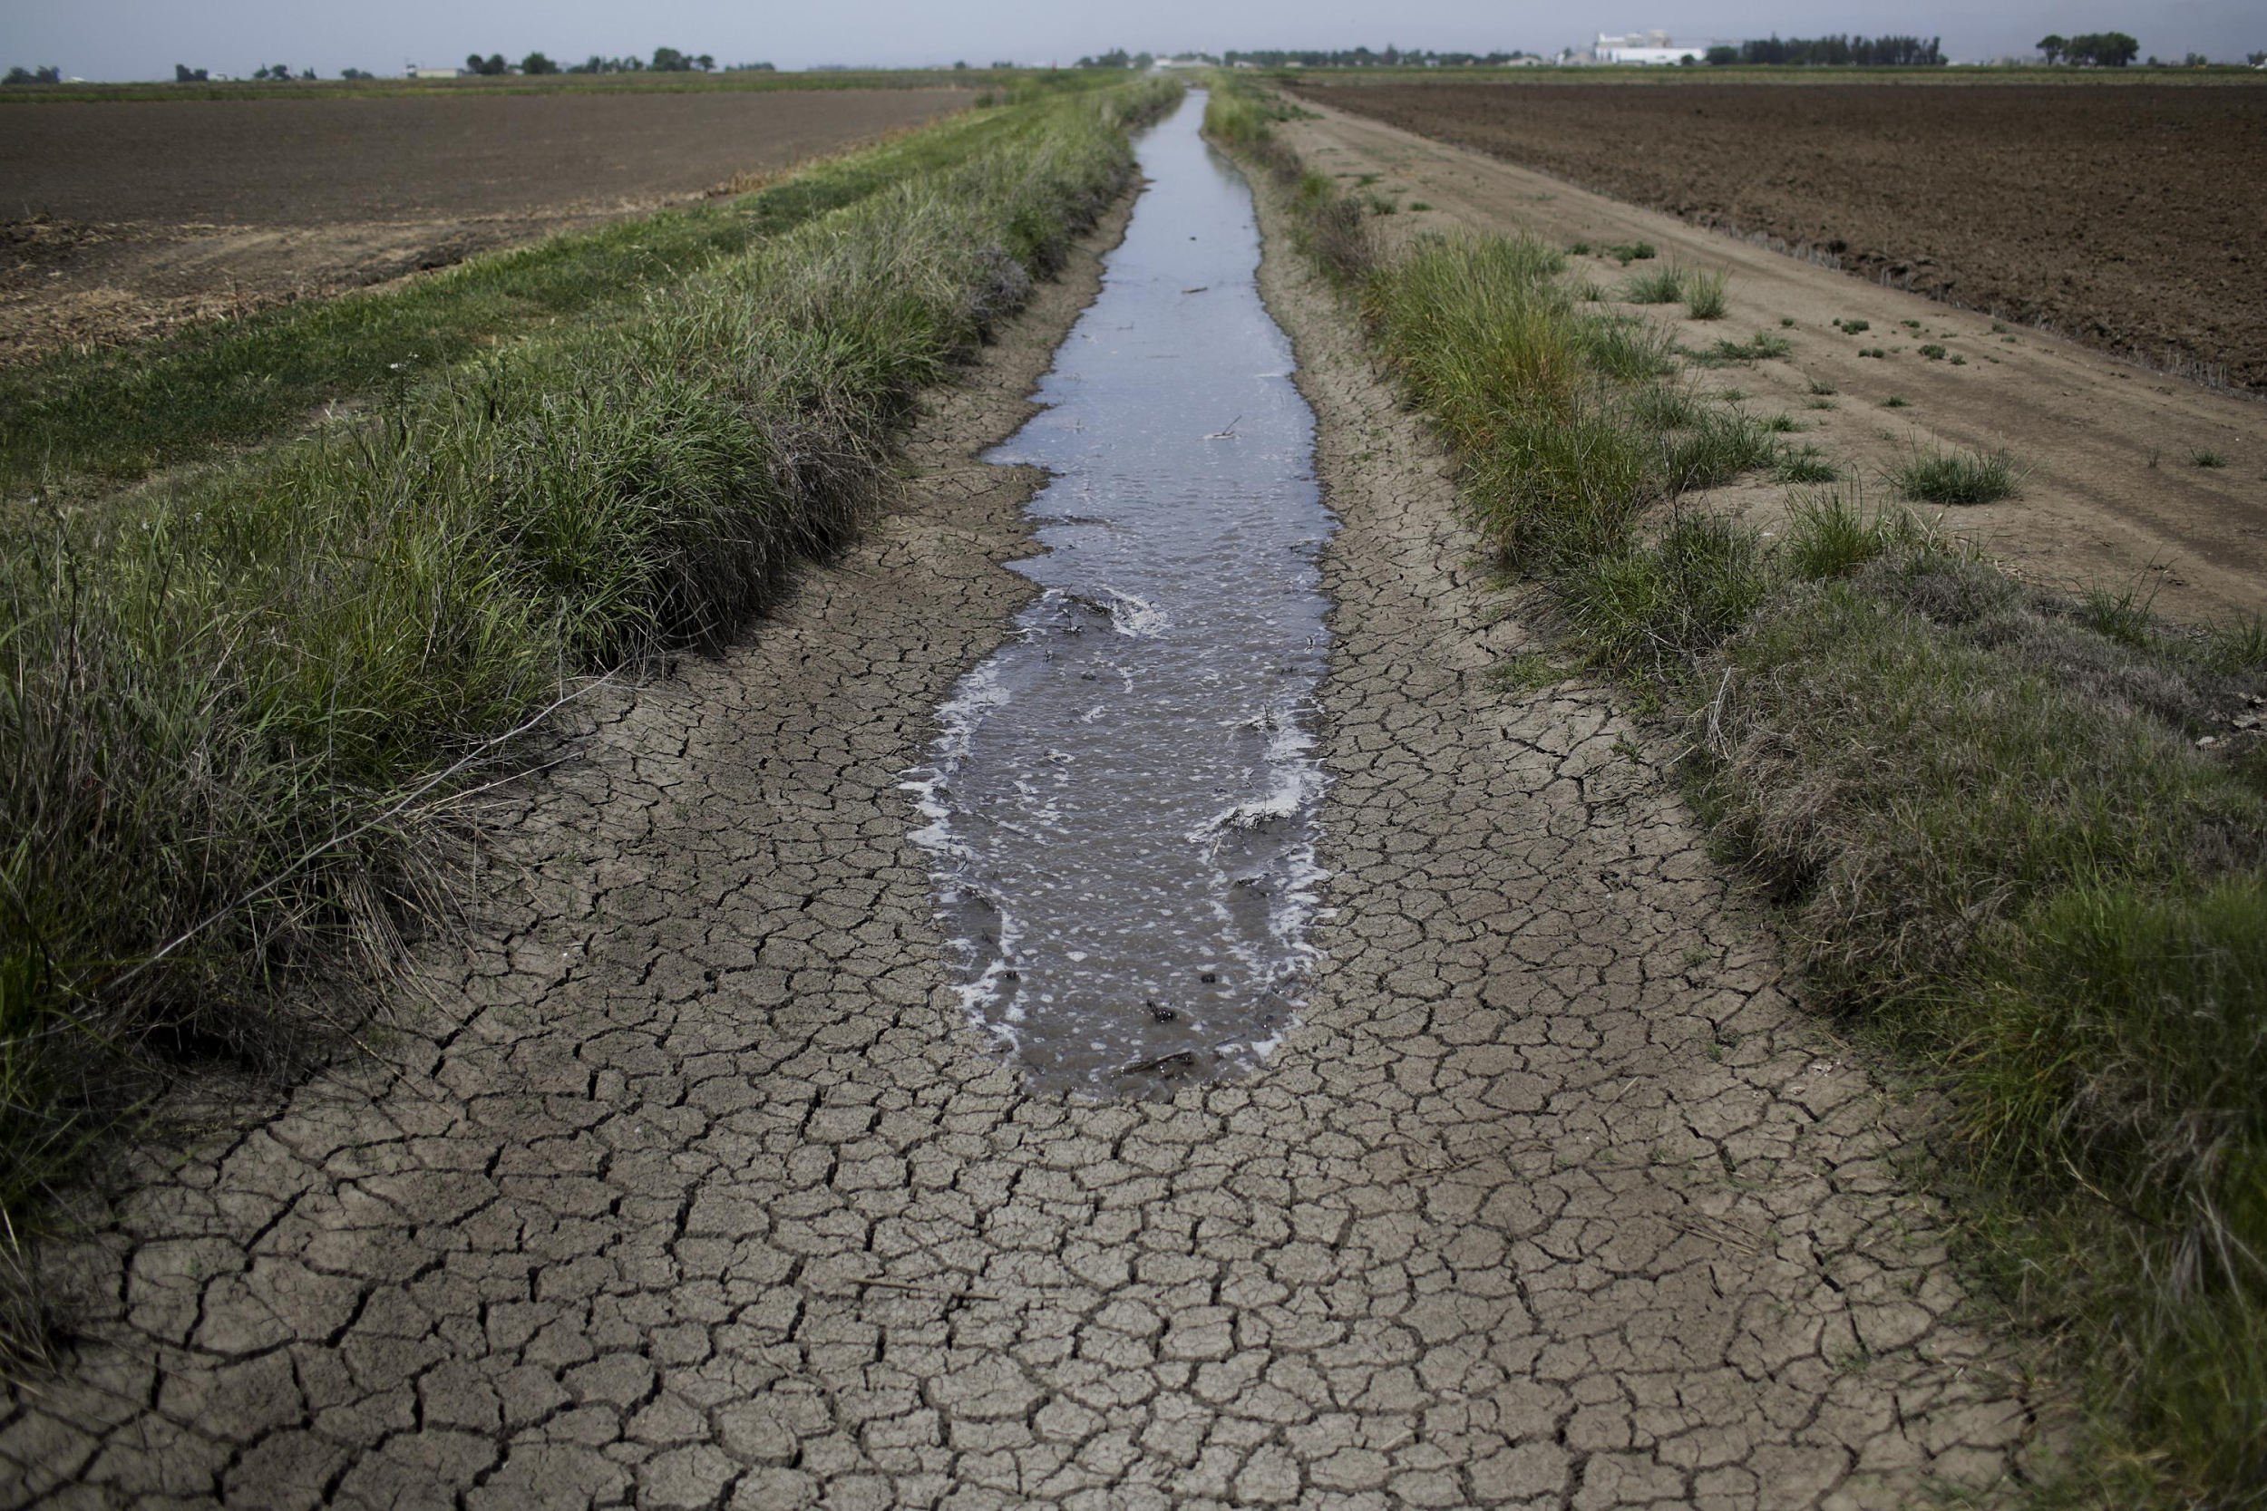
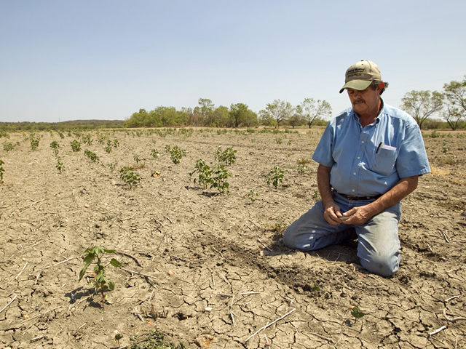
Not enough water for everyone.
Notes:
Alex: ask the kids to look at the images and guess what the problem is.

Slide 8
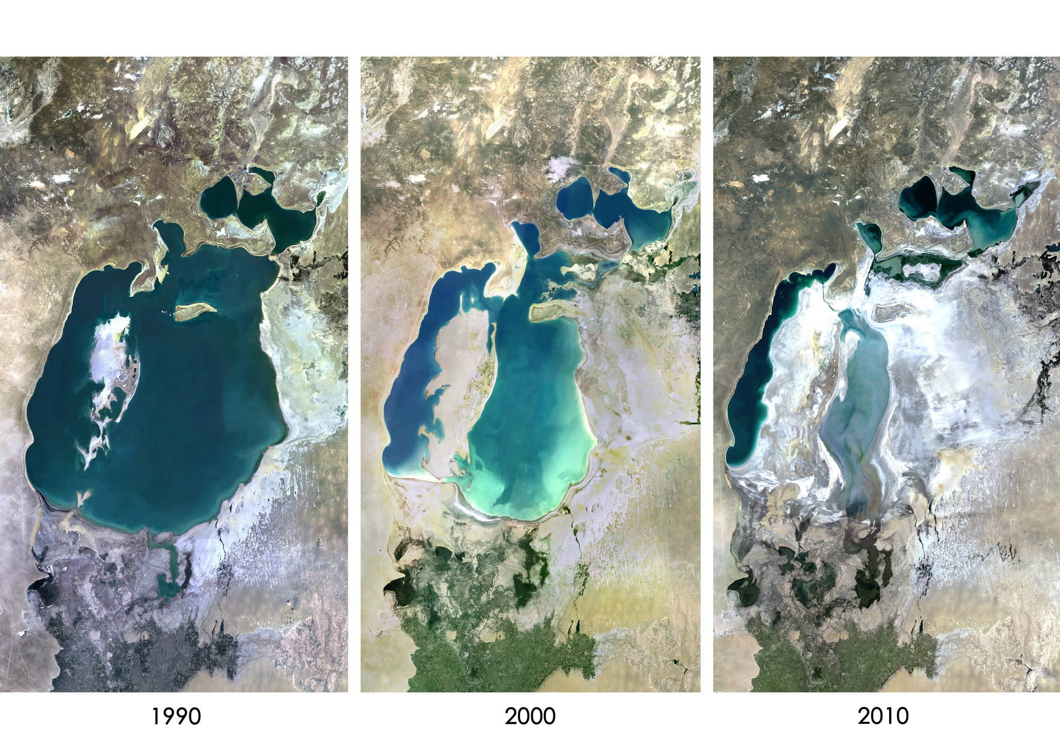
What are the consequences of our water use?
The Aral Sea - Kazakhstan

Slide 9
Can you guess how many litres of water is needed to make these different foods?

Slide 10
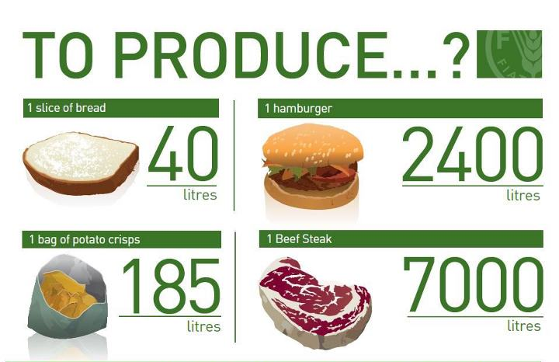
What about these products?

Slide 11
And how about a T-Shirt?

Slide 12
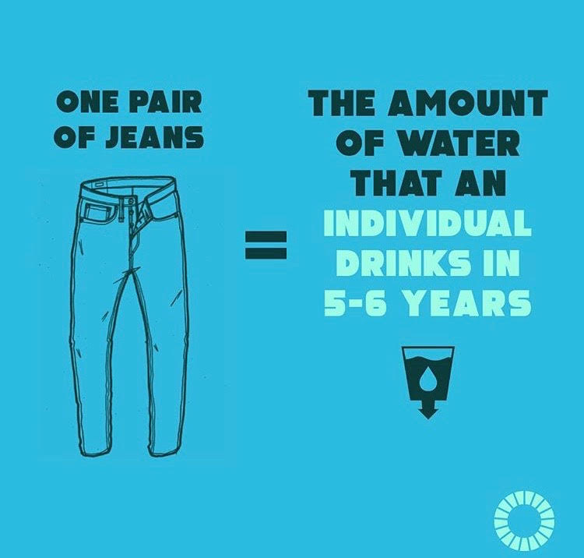
And some jeans?

Slide 13
We need to start thinking about how we can use our resources without damaging our future generations’ needs.
Notes:
Advay

Slide 14
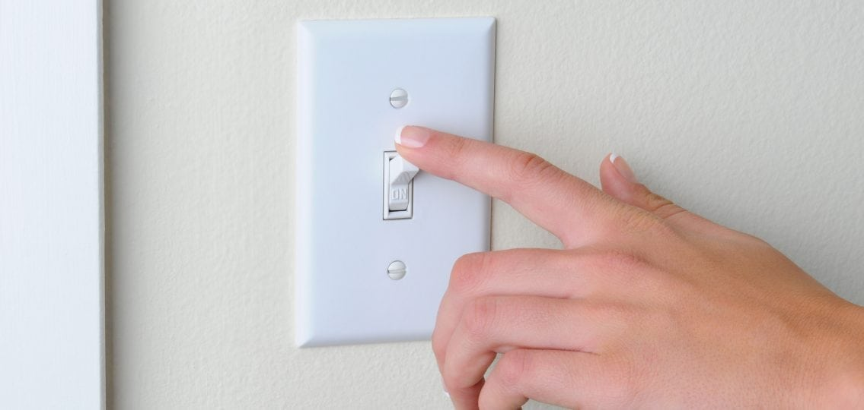
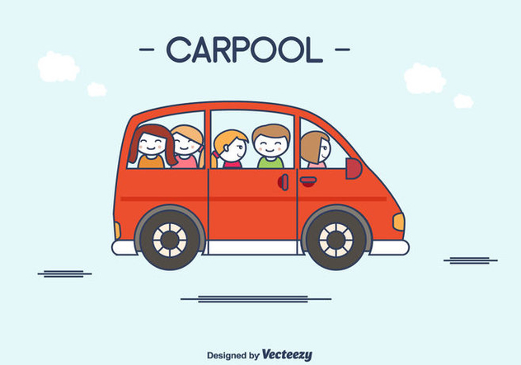
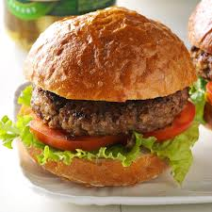
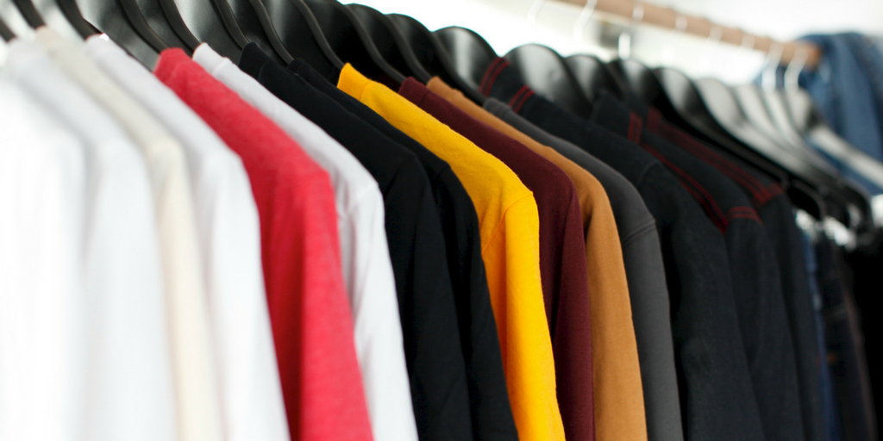
What have we done to help prevent climate change?
Notes:
ALEX:Stopped eating red meat because cow farming produces lots of harmful gases and contributes to deforestation to make land for cows = climate change - however I still eat healthily, start by reducing your intake. Eat chicken!!
AREEN: Stopped using plastic straws and bags because it pollutes our land and oceans, killing the animals - instead I use reusable bags and metal straws.
JOOD: I switch off my AC and lights whenever I don’t need it.
AAMINA: I used to by clothes all the time, but since learning about the effects on the environment for the past 6 months, I’ve only bought one tshirt. I try to buy second hand clothing as much as I can because this reduces the impact on the environment, and only buy clothes if i need it. When I do buy a piece of clothing, I donate one piece of clothing that I have in my cupboard that I never wear to charity.
ADVAY: I carpool - this reduces CO2 emissions and helps slow down climate change
Advay - tell kids what they are doing on thursday and why
. All your teachers will be be trying their best to reduce how much energy they use by switching of their electronic devices. But the teachers cant do it themeslves. It is now up to the rest of us to try and follow in their footssteps. Earth hour is just a reminder that even the smallest acts will add up and will have a huge impact in protecting this beautifulw world we all share. Thank youu.

